Slide 1

Ultimate Guide to Upgrade your Umbraco v7 and v8 Projects to v11
BY NURHAK KAYA
Technical Architect & Umbraco MVP

Slide 2
Agenda
Introduction
Is it time for Umbraco upgrades?
What upgrade options are there?
12 upgrade steps
Final notes and future Umbraco upgrades
Q&A

Slide 3
Introduction
My name is Nurhak Kaya.
I am a Technical Architect at Great State in Bristol, UK. Great State is a digital agency and Umbraco Gold partner, as well as one of the sponsors of Umbraco Spark.
I am an Umbraco Certified Master and an Umbraco MVP. I am also a Umbraco Community Team member.
I have been working with Umbraco since 2014. I have worked with various versions of Umbraco (v4, v6, v7, v8, v9, v10 and v11).
I contribute to Umbraco in multiple ways, e.g., writing articles, answering questions, organising events, talking at events, working on PRs etc.

Slide 4
Is it time for Umbraco upgrades?

Slide 5
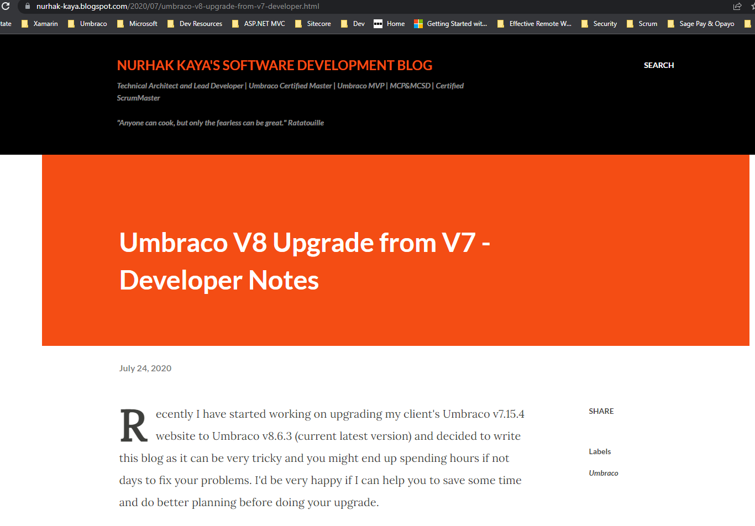
Absolutely yes!
This is not an upgrade but a fresh start!
v7 is fast approaching its End of Life in September 2023.
v8 is entering its security-only phase in February 2024.
No new features for v8.
No more v8 releases after February 2025.
v9 was released in September 2021.
Most recent Umbraco CMS version is v11.1.0, which is built on .NET 7.

Slide 6

Why was the .NET move so important?
There were many reasons that one could say about moving a .NET Framework project to .NET, but the most obvious reason was that Microsoft stopped working on the older technology of .NET Framework.
This meant that an Umbraco upgrade to .NET was absolutely necessary.
Umbraco HQ got together with the Umbraco Community to move the code base to .NET.

Slide 7
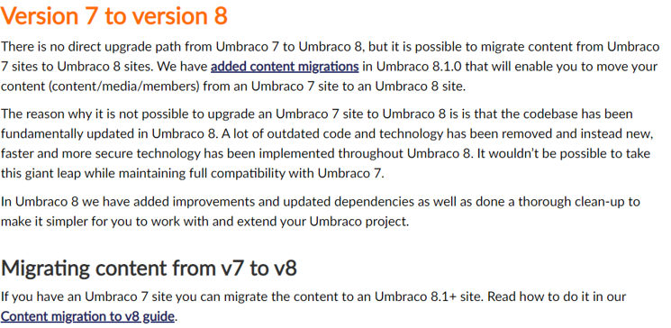
What has changed from v7 to v8?
A lot of old and legacy code was removed while new APIs and features were introduced.
This created a lot of breaking code changes between v7 and v8 which made the upgrades from v7 to v8 practically impossible.
What was allowed was to migrate the content and media.

Slide 8
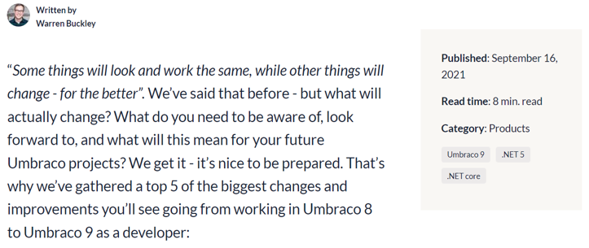
What has changed from v8 to v9?
In a nutshell, the main changes were to migrate the Umbraco codebase from.NET Framework to.NET without adding any new features.
Once the first v9 version was ready, then the new Umbraco and .NET features followed.
Umbraco CMS is now more future-proof and has much better performance, as well as support for the latest security improvements and.NET features, thanks to the completion of the Umbraco.NET migration.

Slide 9
What upgrade options are there?

Slide 10
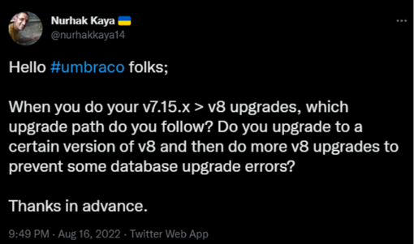
No direct upgrade path from v7 to v8, but content migration is possible.
If you have a lot of custom code, it could be better to spin up a new Umbraco v11 website, create your Umbraco objects, and then write some scripts to do your content migration.
Another approach could be using some 3rd party software to push your content into there and then get your content data directly from this 3rd party software for your v11 website (after doing some data transformations).
The final approach is to spin up new Umbraco websites, migrate the content, and migrate the custom code. Recently, my colleagues and I have carried out a number of upgrades for a number of clients, which has further shaped this approach. This approach will be what I focus on going forward.

Slide 11
12 upgrade steps

Slide 12

Step 1 – Create back-ups!
It is always a good habit to create backups for both your source code and database, before and after each major step.
This is a big ‘upgrade’ and things can always go wrong!

Slide 13
Step 2 – Make sure your v7 version is min v7.14.0.
If not, then upgrade your v7 project to min v7.14.0.
It is best to upgrade it to the latest version of v7.

Slide 14
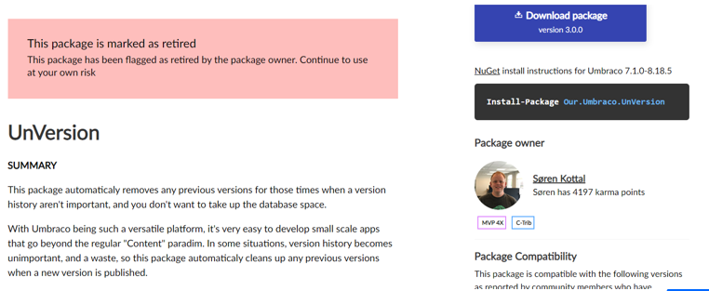
Step 3 – Clean up all the things that you won’t need.
If you don’t need some of your data, then simply delete it.
Remember to empty your Umbraco project’s recycle bin after deleting your items.
Clean up your database version history. You can use the UnVersion package or run your own SQL script to do this.

Slide 15
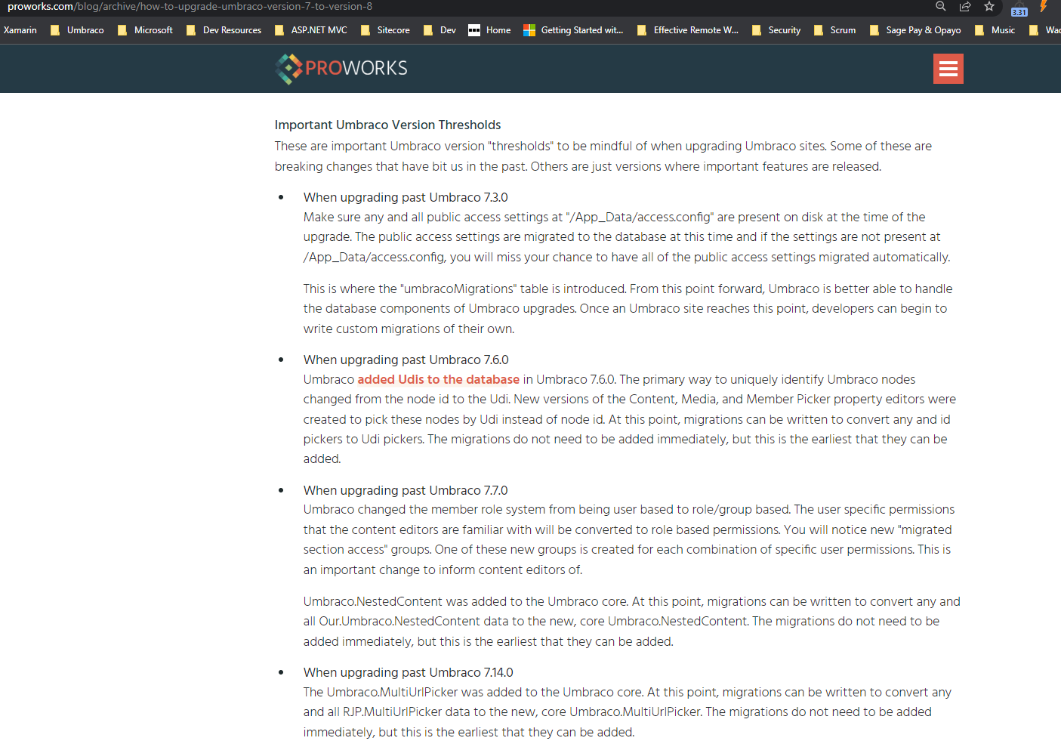
Step 4 – Run pre-migration health checks.
Use the Pre-migration health checks package for this.
This package will help you identify some problems which may prevent the database from being migrated to v8. If there are any problems, fix them before jumping to the next step.
At this point, look at this great blogpost by ProWorks so that you won’t miss the important details about Umbraco version thresholds.
Also, take a look at the new uSync Migrations tool as well as some other approaches, like Moriyama’s approach or Enterspeed’s integration apps.

Slide 16
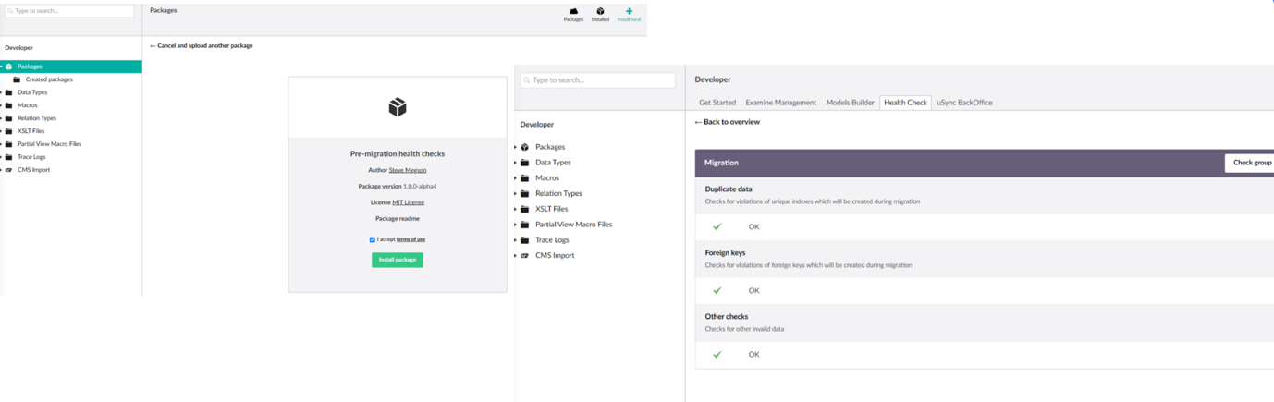
Step 4 – Run pre-migration health checks.
You can use the Package section in the Umbraco backoffice to manually install the Pre-migration health checks package using its zip file.

Slide 17
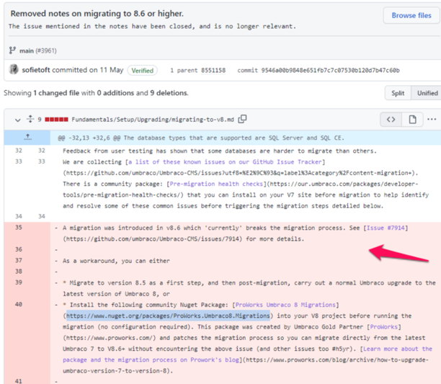
Step 5 – Spin up a new v8.5.5 website.
It is important to spin up a new v8.5.5 website first as v8.6 has some migration changes that break the v7 to v8 migration.
You can try to go for a higher v8 version using ProWorks.Umbraco8.Migrations package. In any case, make sure that you can log in to the Umbraco backoffice but do not create any Umbraco objects, yet.

Slide 18
Step 6 – Update the v8 web.config file for the connection string and Umbraco version number.
Replace your v8 website’s connection string with the v7 connection string. Also, update the Umbraco version from 8.5.5 to your v7 website’s version number.
Umbraco.Core.ConfigurationStatus is where you’ll find your Umbraco version number.
These changes will trigger the content migration when you run your v8 project.

Slide 19
Step 7 – Build and run the v8 project and complete the database upgrade and content migration.
It is time to build and run your project. I recommend running it without debugging.
After running your project, you should see the Umbraco installer screen which should upgrade your database and files. This should also do the content migration.
Depending on the complexity of your project, you might see some problems. There are quite a few answers on Umbraco Forum and StackOverflow, hopefully, some answers would help you.
If all has been good, then you should be able to log in to your new v8 website’s Umbraco backoffice. If you end up seeing more and more problems, you might want to consider a different approach for your upgrade.

Slide 20


Step 8 – Upgrade your v8.5.5 project to the latest version of v8.
If you have reached this point, then you should make yourself a nice cup of coffee (or something stronger) and enjoy it because you have just completed the trickiest bit of your upgrade.
It is now time to upgrade your v8 project to the most recent version of v8 and prepare to migrate to.NET 6 and v10!

Slide 21
Step 9 – Spin up a new .NET 6 v10.0.1 Umbraco website.
Spin up a new v10.0.1 website and complete your database installation without creating any Umbraco objects.
Make sure you can log in to the Umbraco backoffice and check that things are good.
For this step, you can potentially use the latest version of v10, but it is generally a good idea to be as close as possible to v9, hence this version.

Slide 22
Step 10 – Update your appsettings.json file to use the v8 connection string for your v10 project.
There is no way to directly upgrade your v8 website to v10. This is because v8 runs on the.NET Framework and v10 runs on.NET 6, but you can migrate your content again.
After updating the v10 project's connection string to use the v8 project's connection string, run the v10 project to initiate the database upgrade and content migration.
As the v8 database schema is very similar to the v10 database schema, things should easily be upgraded and migrated at this point.
When you're finished, go to your v10 website's Umbraco backoffice and double-check your content.

Slide 23
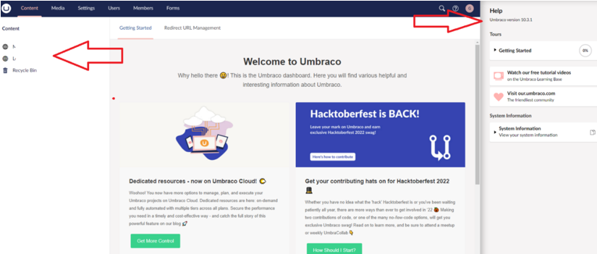
Step 11 – Upgrade your v10.0.1 project to the latest version of v10 and then v11.
It is time to upgrade your v10 project to the latest version of v10 using the Package Manager Console (or whatever you are using).
After completing the v10 upgrade, upgrade your project to.NET 7 and the most recent Umbraco v11.
Make sure that all is still good after your latest upgrade is complete.

Slide 24

Step 12 – Create your custom code.
This is the final step of your upgrade.
You can now create your custom changes for your brand-new v11 website and create new Umbraco objects or update them or do other things that you might need to do like creating templates etc.

Slide 25
Final notes and future Umbraco upgrades

Slide 26
Final notes and future Umbraco upgrades
Change is inevitable and will continue to happen and it is important to adapt(and upgrade your projects) at the right time with the right tools.
Depending on the complexity of your projects, you might have some additional steps, and if you do, please remember to share your knowledge with the rest of the friendly Umbraco community.
With regards to the future Umbraco upgrades; Umbraco have started to release a new minor CMS version every 6 weeks and a new major version every 6 months. You should keep an eye on the Umbraco release schedule and continuously do your Umbraco upgrades.
For more details, please check my Skrift.io articles about Umbraco upgrades.

Slide 27




Thank you for joining me today! #h5yr Any questions?
https://twitter.com/nurhakkaya14
https://www.linkedin.com/in/nurhak-kaya-53825051/
https://github.com/NurhakKaya
https://www.greatstate.co/

